Slide 1


Slide 2

WEB SCRAPING AND EXPLORATORY DATA ANALYSIS ON IMDB MOVIES
Team:
Name: Surya Sanjeev | Name: Pujitha | Name: Nagarjuna
Qualification: B.Sc. | Qualification: B.Com | Qualification: B.A

Slide 3
Problem Statement : To Perform Data Analysis On IMDB Movies With Respect To Rating. Website URL: https://www.imdb.com/search/title/?countries=us&title_type=feature&num_votes=10000,&sort=user_rating,desc

Slide 4
Libraries Used:
NumPy
Pandas
Matplotlib
Seaborn
Requests
Beautiful Soup
Steps Involved:
Web scraping the IMDB Website using Requests and Beautiful Soup, extracting the required data for analysis.
Applying Regular Expressions (Regex) on the data to simplify for analysis.
Using NumPy and Pandas Libraries create Data Frames and Storing it to IMDB.csv file.
Using the IMDB.csv we apply visualizations using Matplotlib and Seaborn Libraries.

Slide 5
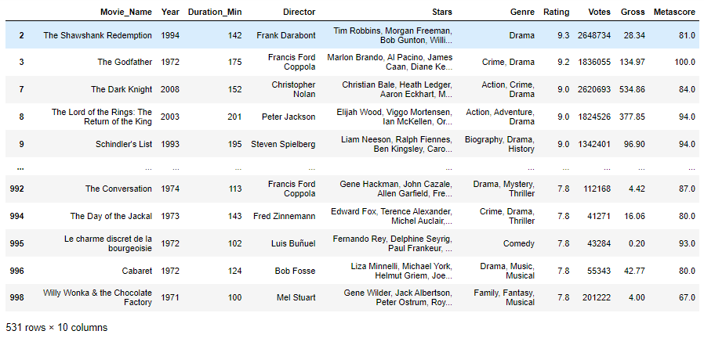
Data Cleaning:
Identifying Null Values.
Identifying Missing Values.
Treating rows and columns with null values and missing values.
Extracting required data from columns to create another columns using regular expressions.
Treating columns and converting required columns from object to int or float datatype.
Final Data Frame:

Slide 6
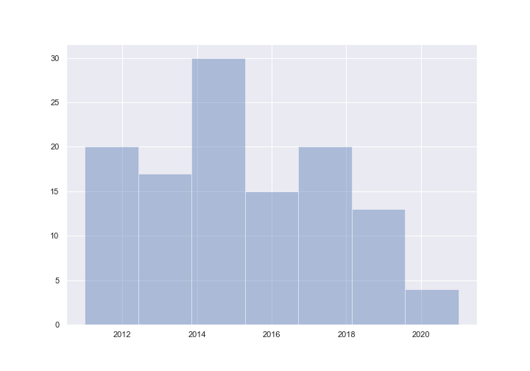
Movies Released Year wise From 2010:
Observations:
From the plot we can observe that:
The Highest Number of movies are released in the Year 2014.
The Least Number of movies are released in the Year 2020.

Slide 7
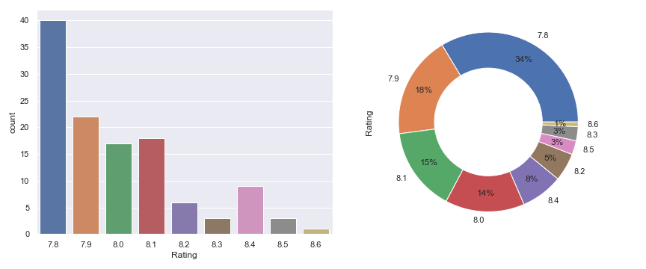
Distribution of Ratings:
Observations:
From the plot we can observe that:
The Highest Rating’s given are 7.8.
The Least Rating’s given are 8.6.
From the pie chart we can observe percentage of Rating’s in the Data Frame.

Slide 8
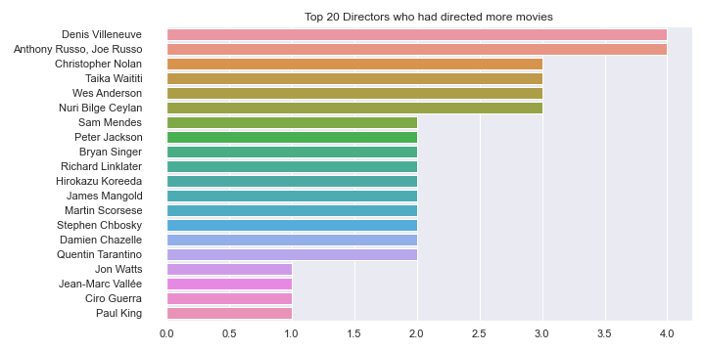
Top 20 Directors Who Had Directed More Movies:
Observations:
From the plot we can observe that:
Denis Villeneuve and Anthony Russo, Joe Russo are the directors who directed 4 movies.
Christopher Nolan, Taka Waititi, Wes Anderson, Nuri Bilge Ceylan are the directors who directed 3 movies.

Slide 9
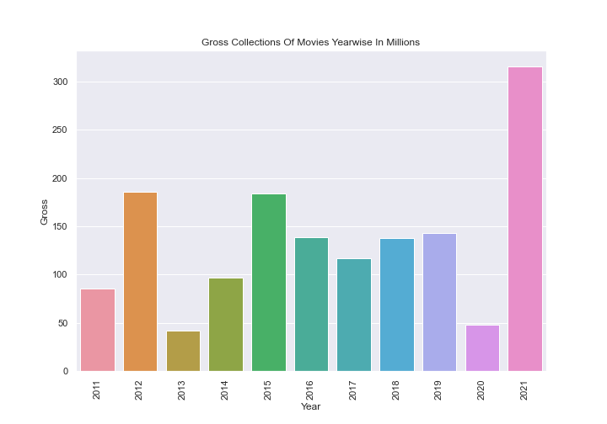
Gross Collections Of Movies Year wise In Millions:
Observations:
From the plot we can observe that:
The Highest Gross collected was in the Year 2021.
The Least Gross collected was in the Year 2013.

Slide 10
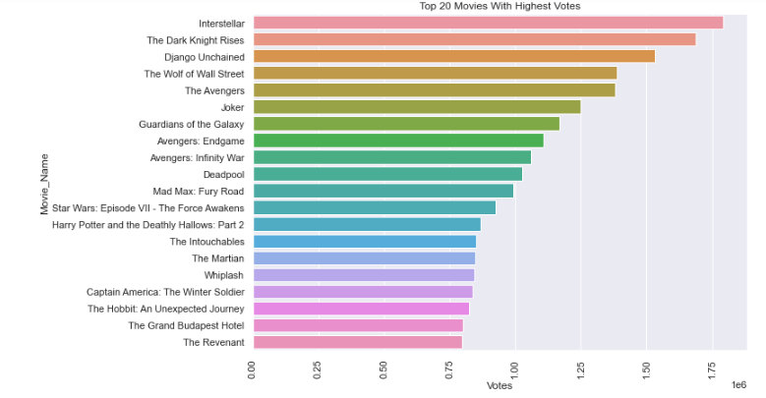
Top 20 Movies With Highest Votes:
Observations:
From the plot we can observe that:
The movie with highest votes is Interstellar.

Slide 11
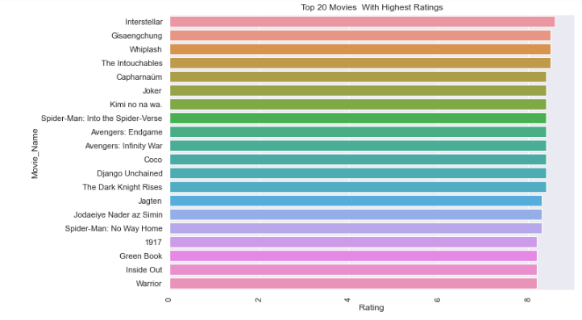
Top 20 Movies With Highest Ratings:
Observations:
From the plot we can observe that:
The movie with highest rating is Interstellar.

Slide 12
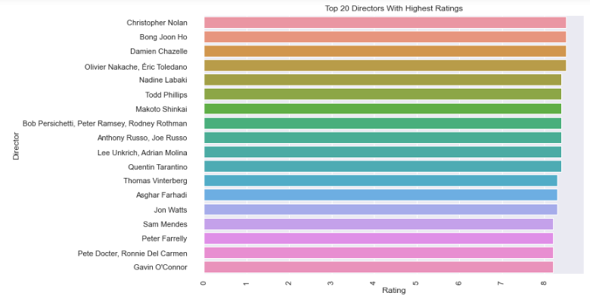
Top 20 Directors With Highest Ratings:
Observations:
From the plot we can observe that:
The director with highest rating is Christopher Nolan.

Slide 13
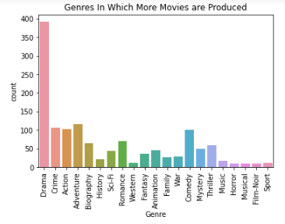
Genres In Which More Movies are Produced:
Observations:
From the plot we can observe that:
The Highest Movies are from the Genre Drama.
Next to Drama more movies are from Crime, Action, Adventure Genre.

Slide 14
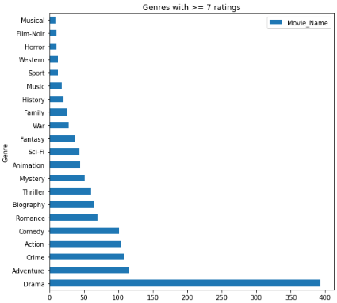
Top Genres With Highest Ratings:
Observations:
From the plot we can observe that:
Genre with highest rating is Drama.
Adventure, Crime, Action, Comedy are the genres which got high ratings after Drama.
Musical, Film-noir, Horror, Western are the genres which got less ratings.

Slide 15
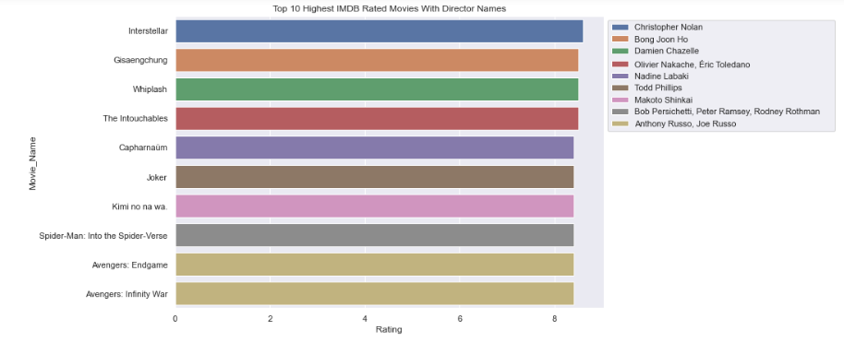
Top 10 Highest Rated Movies With Director Names:
Observations:
From the plot we can observe that:
The movie with highest rating is Interstellar directed by Christopher Nolan.

Slide 16
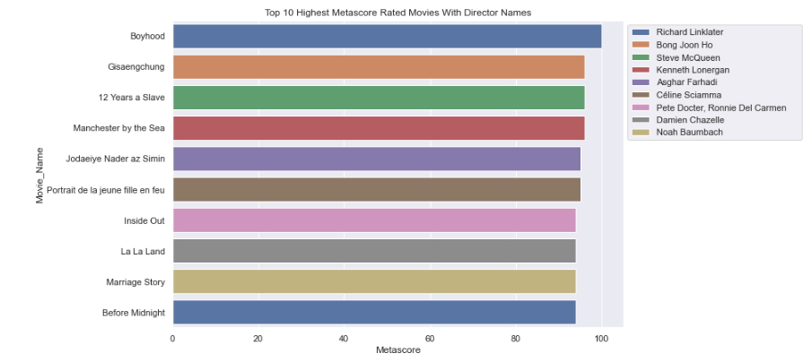
Top 10 Highest Meta Score Rated Movies With Director Names:
Observations:
From the plot we can observe that:
The Movie with Highest Meta Score Rating is Boyhood directed by Richard Linklater.

Slide 17

Conclusion:
This project can be used to look for best movies in IMDB by sorting in accordance with the user requirements like Director, Year, Genre, Rating, Votes, Meta score.

